Slide 1
LUAU Initiative
Limala’u Kaneyo Hirata,
Cross-Cultural Studies, Master’s Candidate,
University of Alaska, Fairbanks

Slide 2
1 in 3 High school students received an F last academic school year 2015-2016 (http://www.asdk12.org/media/anchorage/globalmedia/8.25.16%20MECAC.pdf)

Slide 3
Hendricks, P. (1998) “Developing Youth Curriculum Using the Targeting Life Skills Model” http://www.extension.iastate.edu/4H/skls.eval.htm
Palu, A. K. (2014). Factors Related to High School Dropout Rates Among Native Hawaiian and Other Pacific Islander Youths in Salt Lake and Utah Counties in Utah.
Tatafu, M. (1997). Early School Leaving: A crisis in secondary school in Tonga. University of
Wollongong Thesis Collection (http://ro.uow.edu.au/theses/1874).
Vakalahi, H. F. O. (2009). Pacific Islander American students: Caught between a rock and a hard place? Children and Youth Services Review, 31(12), 1258-1263.

Slide 4
Family-Related
Peer-Related
Personal-Related
Culture-Related
School-Related
Native Hawaiian and Other Pacific Islanders
School Dropouts
Conceptual framework for factors related to NHOPI high school dropouts. These 5 major factors that influence students to drop out according to Tatafu (1997) and Vakalahi (2009)

Slide 5
Family-Related
Peer-Related
Personal-Related
NHOPI High School Student Dropouts
NHOPI High School Students Decisions to Dropout
DECISIONS TO DROPOUT
Culture-Related
School-Related
Revised conceptual framework of 5 factors related to dropout rates among NHOPI dropouts in Salt Lake and Utah counties in Utah according to Palu (2014)

Slide 6
Makai Reading Initiative and Youth and Adult Mentoring Program
Provide access and navigation tools to help high school students stay in school
High school students to continue on the path of higher education or trade school
Work with school district, especially counselors to learn more about Pacific Islanders and provide access to education opportunities and scholarships
Work with families and older adults by offering access to employment and education opportunities
Work closely with faith based communities and agencies to ensure potential opportunities

Slide 7
Results
2013
35% of NHOPI in Utah drop out rate
2016
15% of NHOPI in Utah drop out rate

Slide 8
Pacific Alliance of Alaska:
Polynesian Association of Alaska
Alaska Pride
Pacific Islanders Center
Hawaiian Civic Club
Pacific Bloom
Tongan Community
Fijian Community
JustServe
Bridge Builders
ASD Administrators:
Bartlett High School
Begich Middle School
Benny Benson High School
Clark Middle School
East High School

Slide 9
Love Understanding Accountability Unity
LUAU INITIATIVE
Identity: Love of God, Love of Self and Family, Love of Community
Bicultural Identity: Understanding self and other cultures and learning to live together, work together, and make sense of culture one was born and culture one is presently a part of
Multicultural Awareness: Accountability to community and aware of other cultures, service opportunities that create a sense of community
Polycultural Wellness: Unity that cultivates and embraces all cultures and equity for all

Slide 10
LUAU Initiative explores:
Identity
Bicultural Identity
Multicultural Awareness
Polycultural Wellness
GOD
COMMUNITY
FAMILY
SELF

Slide 11
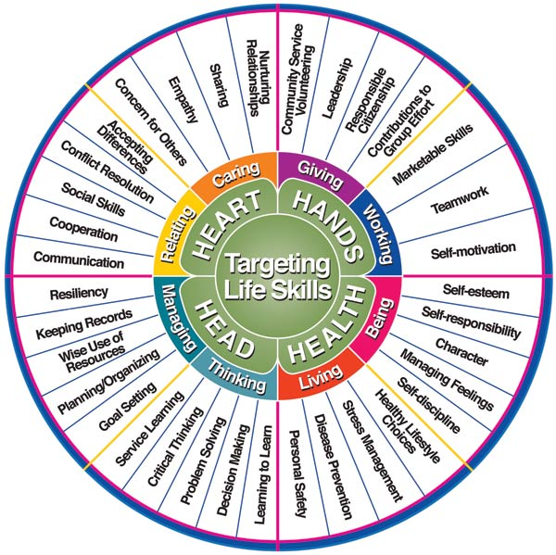
Hendricks, P. (1998) “Developing Youth Curriculum Using the Targeting Life Skills Model” http://www.extension.iastate.edu/4H/skls.eval.htm

Slide 12
Problem: Youth in Urban Anchorage, Alaska are underserved in areas that lack cultural relevant learning experiences, education opportunities and scholarships
Goals: Youth will be actively engaged in academics through empowerment and will be able to develop strong life skills that focus on their heart, hands, head, and health which they will be more self-determined and confident in making positive and healthy choices
Objectives: Students will demonstrate what they have learned through individuals and group presentations learn skills to help them develop a strong sense of cultural identity through performing arts and community service projects that empower students to excel in academics and prepare them to develop positive leadership skills. Utilizing LUAU initiative through stories, education, family, community and school engagement
Input: Pacific Alliance of Alaska Clubs (Poly) in ASD High School and Middle Schools

Slide 13
Students will learn positive life skills using the LUAU Initiative, Revised 5 Factor Model according to Palu (2014) and the 4-H Targeting Skills Model
Students will gain understanding of leadership skills
Students will learn to serve others through community and service learning projects and public performances
Students will learn to conduct workshops, meetings and make presentations in front of the group and in public
Students will develop strategies that will help them be successful in school by setting goals
Students will learn the importance of academic excellence by doing all their assignments and maintaining a GPA of 3.0 and above throughout the school year
Students will learn to help each other and mentor each other
Output measures (Who we reach): 80% of those enrolled in Pacific Alliance of Alaska after school program will maintain a GPA of 3.0 and above
80% of those enrolled in our afterschool program will participate in cultural arts performances and service learning opportunities in the community
100% of the students will learn to appreciate cultural identity and be proud of their cultural heritage

Slide 14
Outcome measures:
Short term
Learning
Awareness
Attitudes
Motivation
Skills
Long term
Higher education
Trade or skill
Future leaders
Engaged in creating a sense of community
Giving back to community
Strong sense of cultural identity

Slide 15
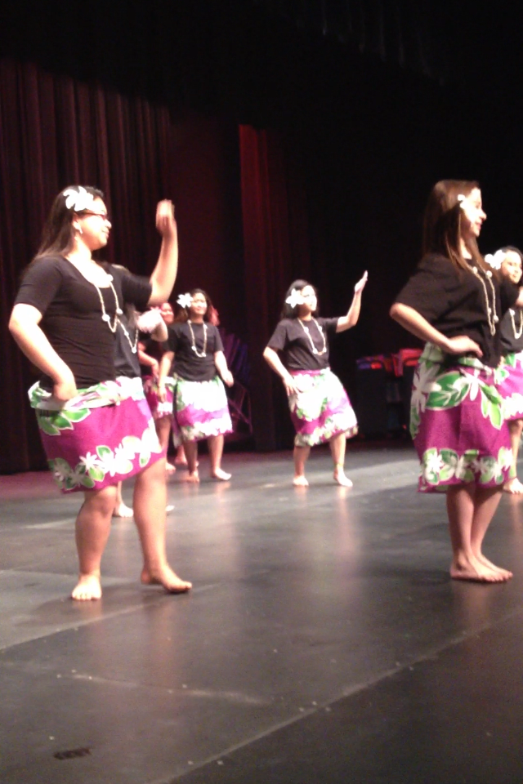
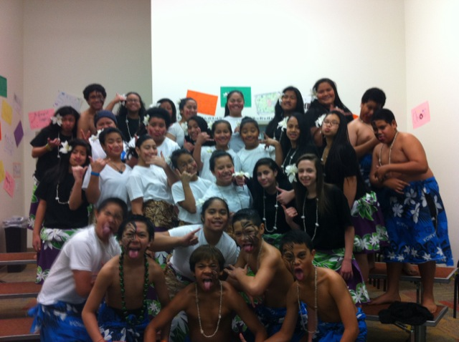
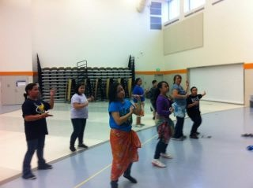
CLARK MIDDLE SCHOOL 2012-2013
CLARK MIDDLE SCHOOL2012-2013

Slide 16
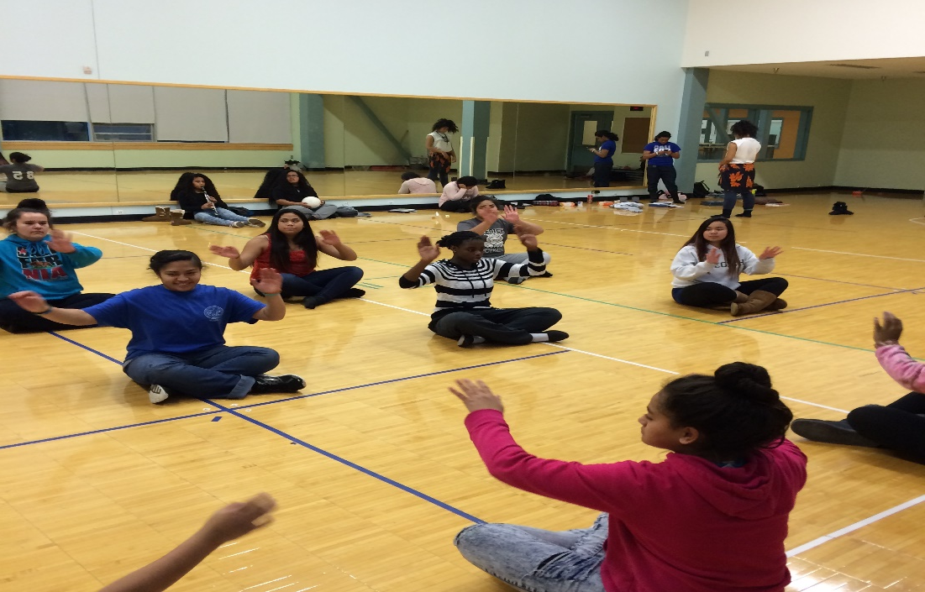
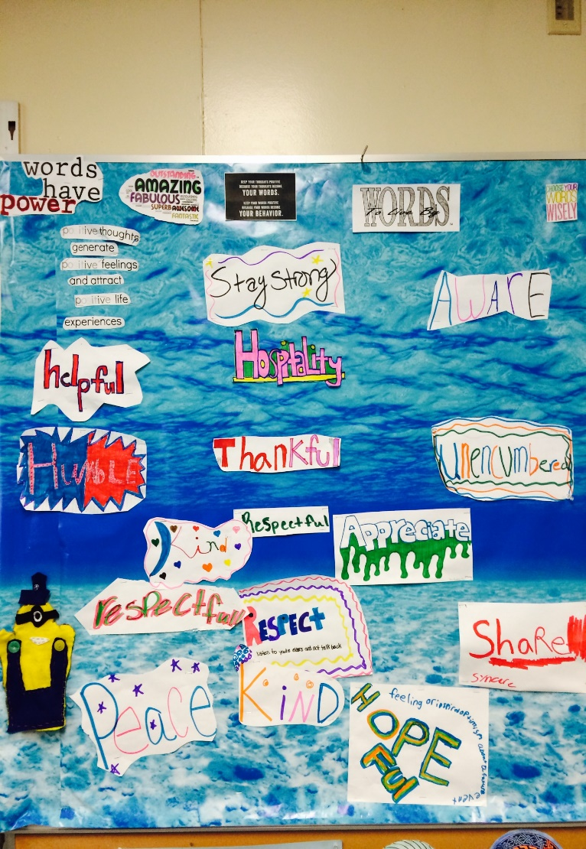
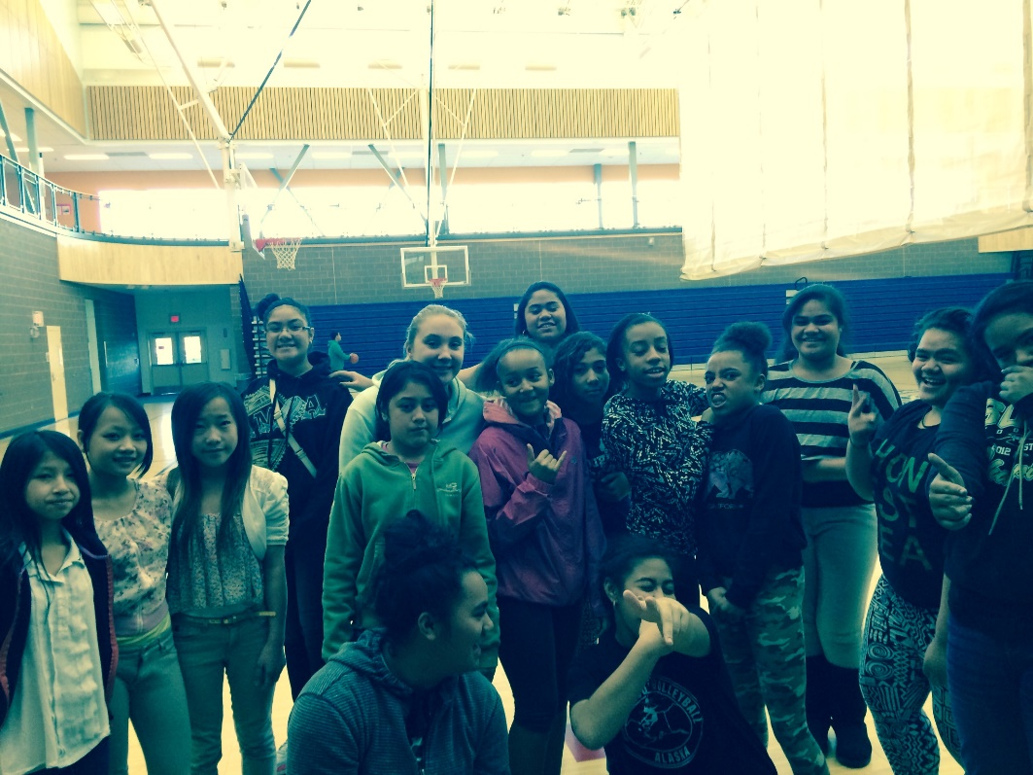
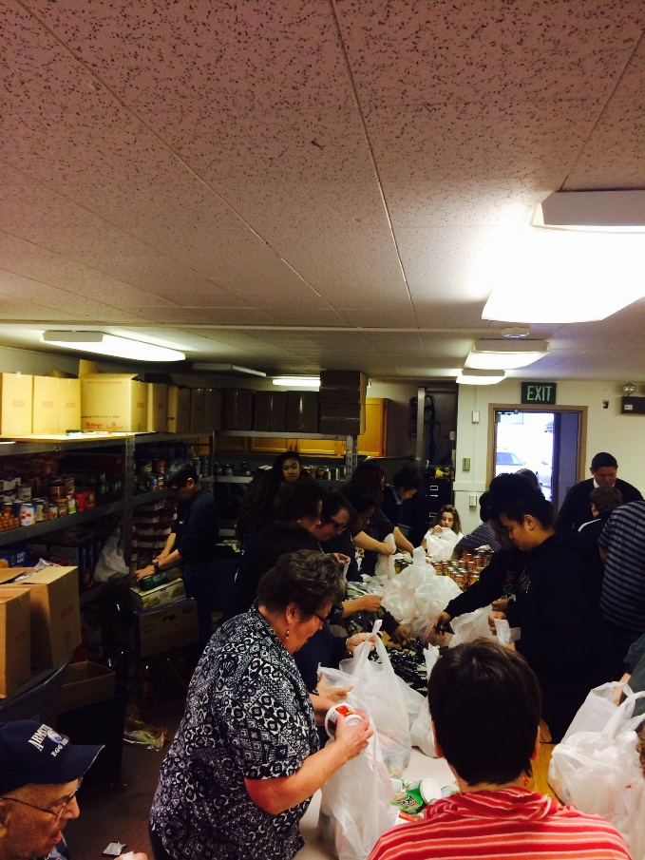
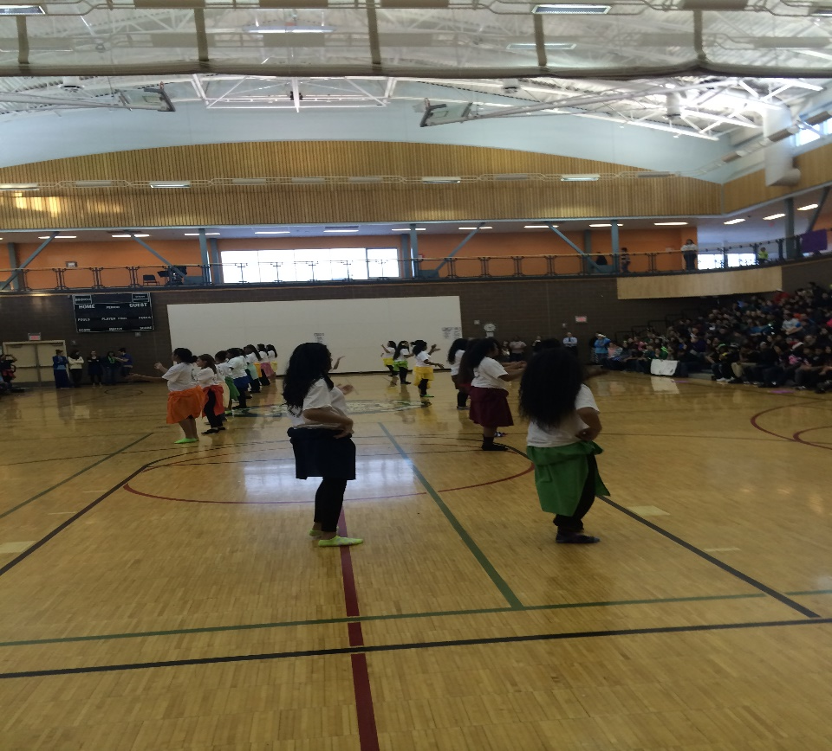
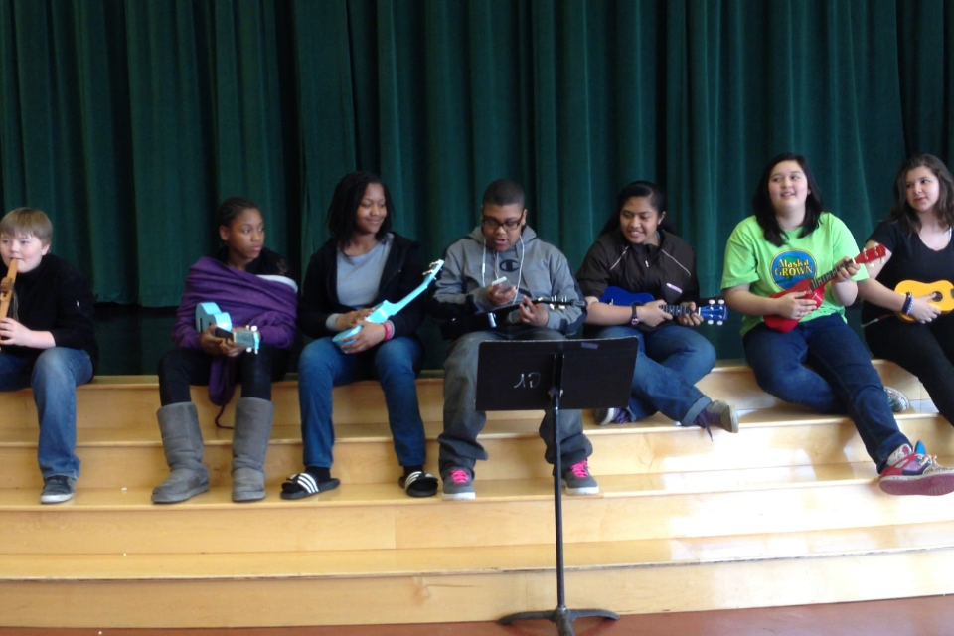
BEGICH MIDDLE SCHOOL 2014-2016

Slide 17
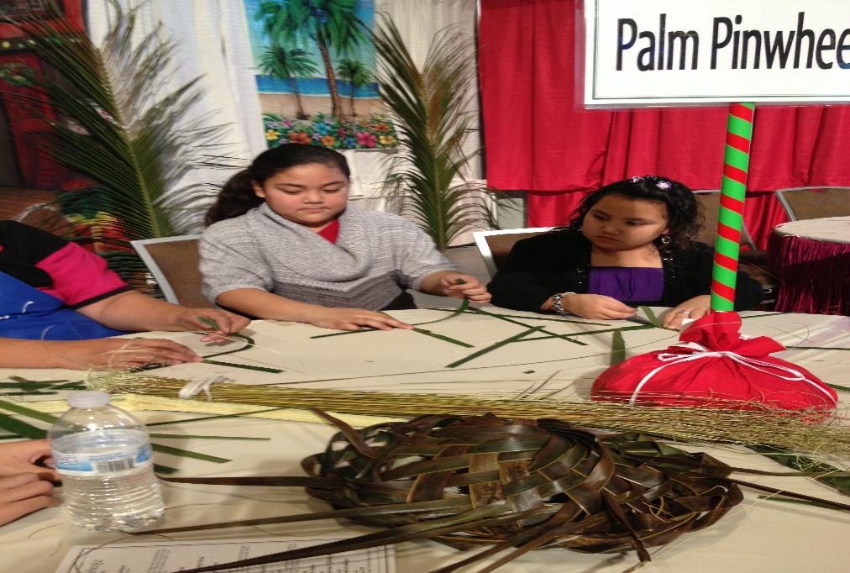
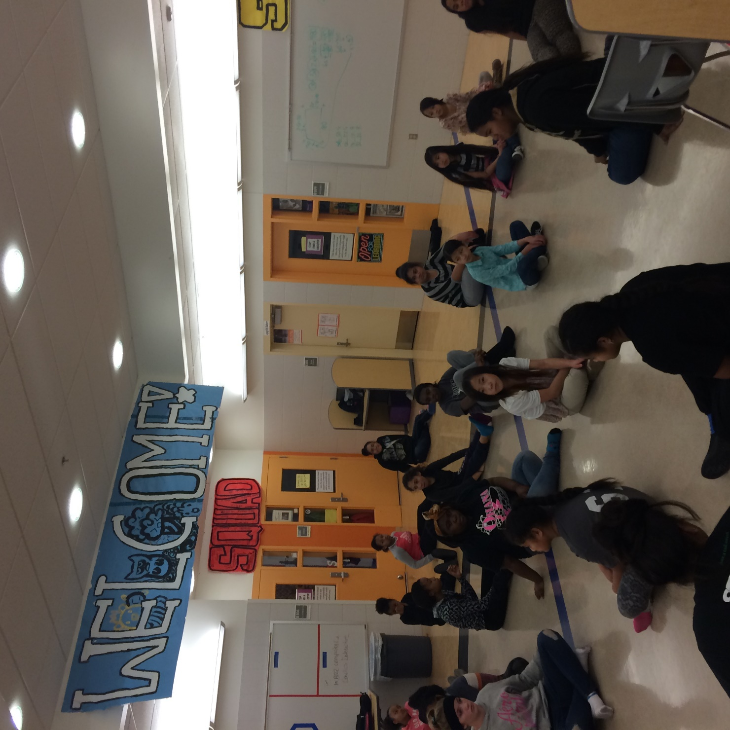
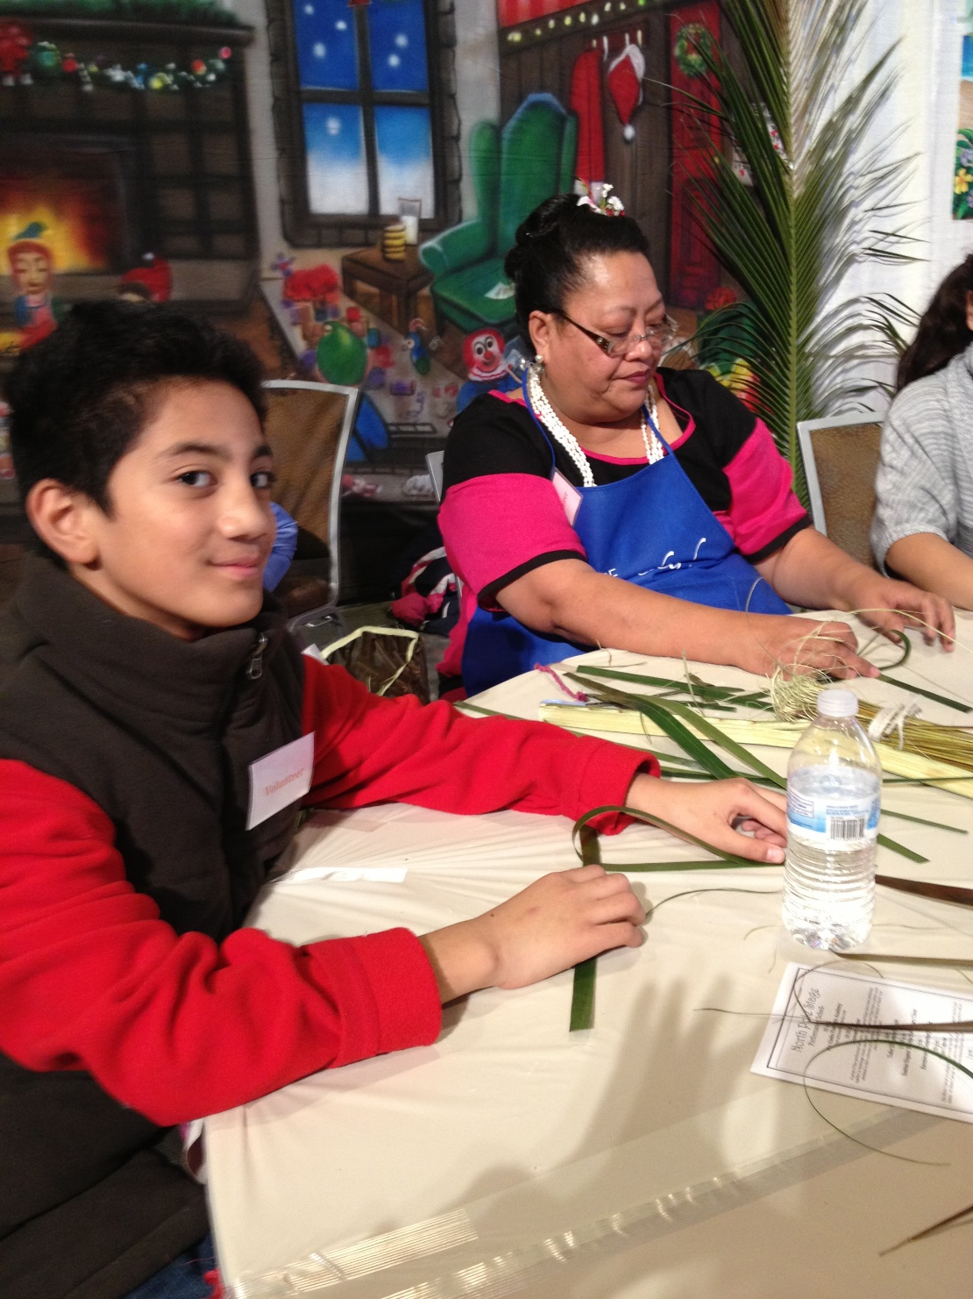
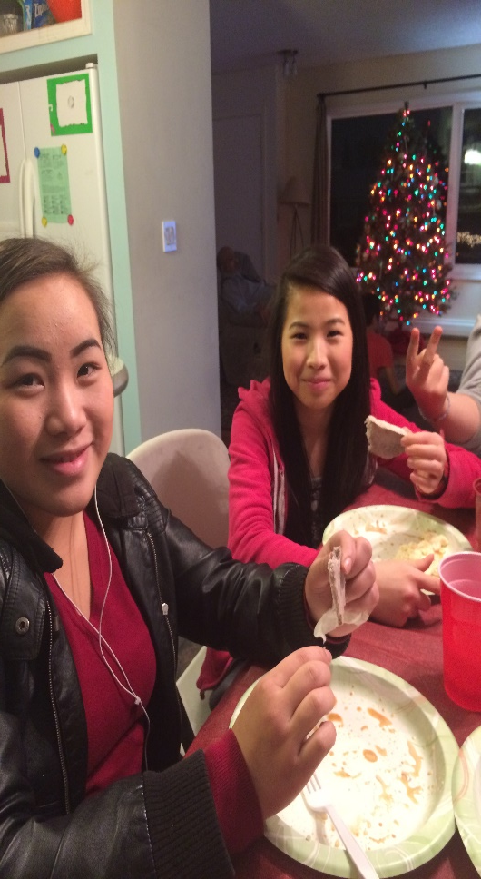

Slide 19
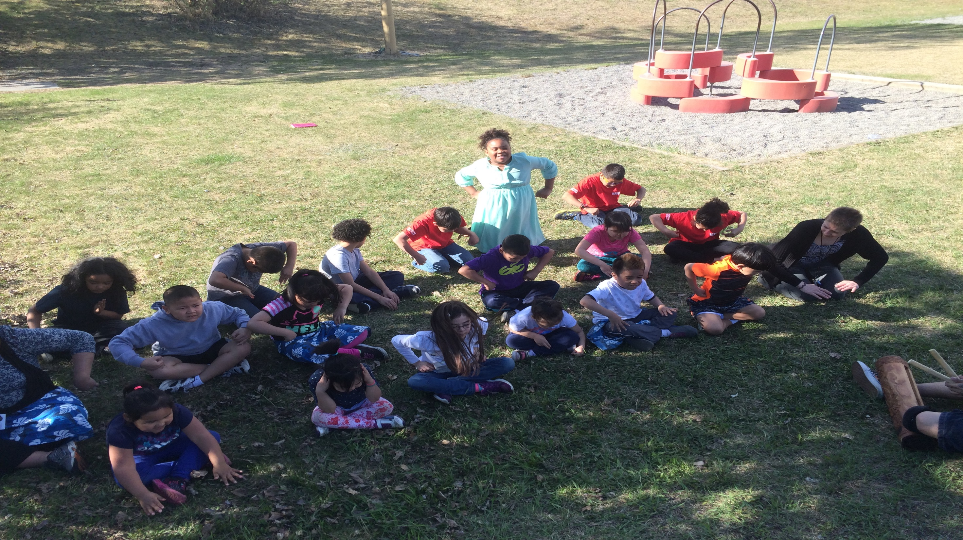
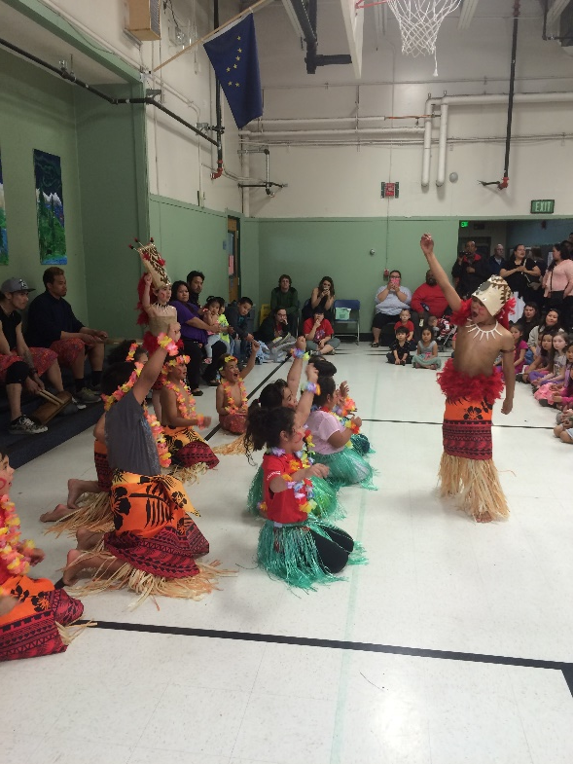
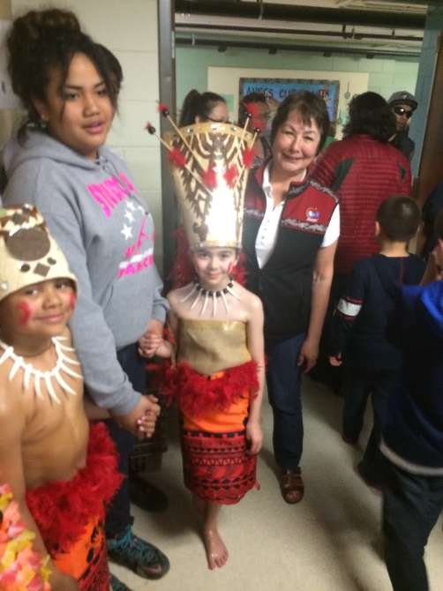
ALASKA NATIVE CULTURAL CHARTER SCHOOL
2014-2016

Slide 20
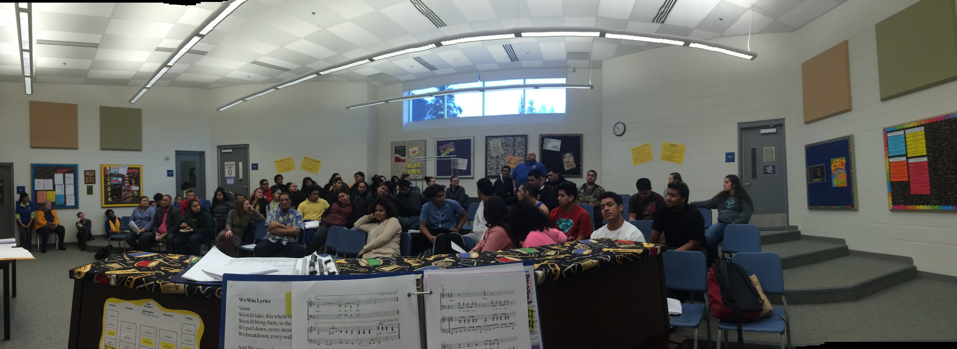
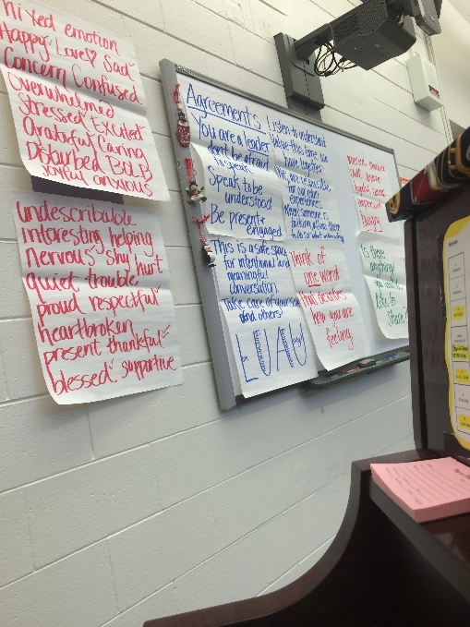
BARTLETT HIGH SCHOOL (2015-2016)

Slide 21
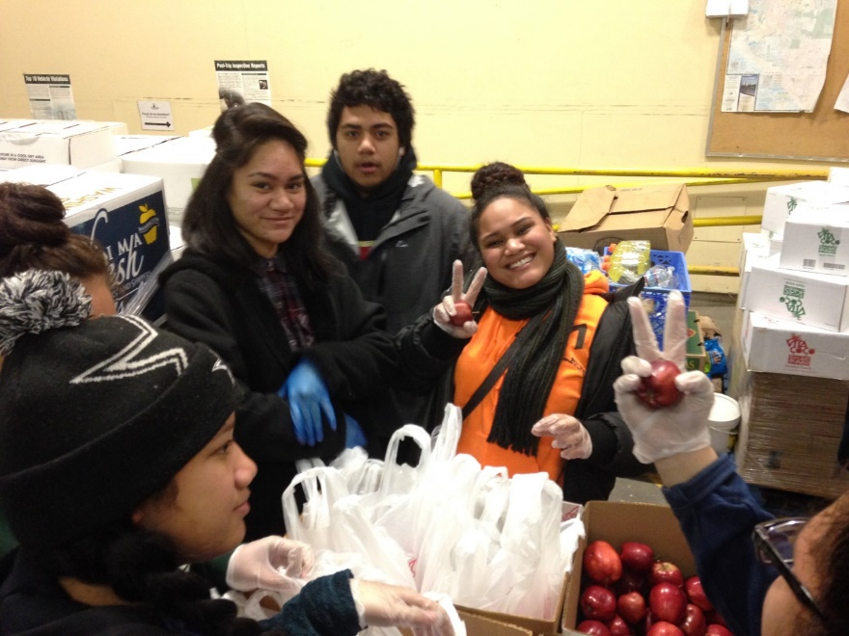
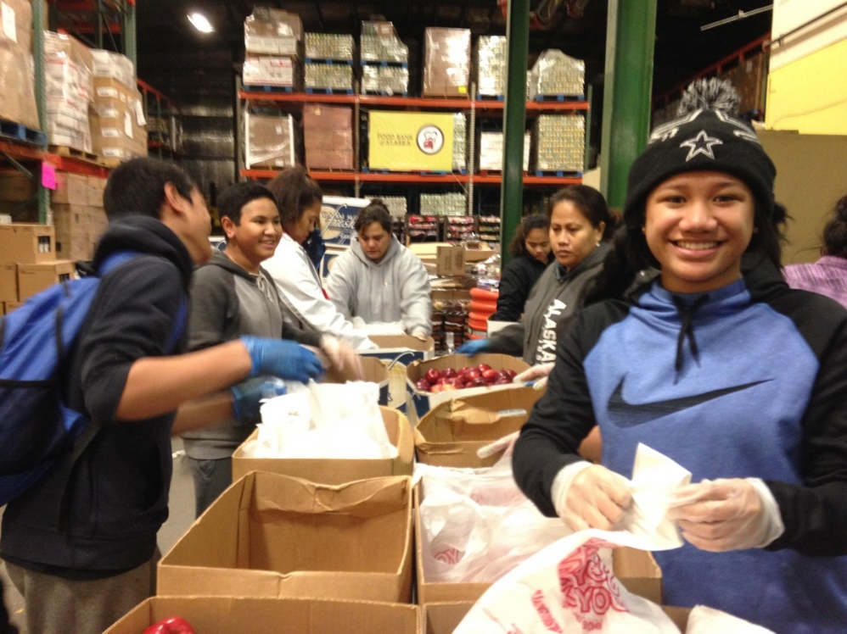
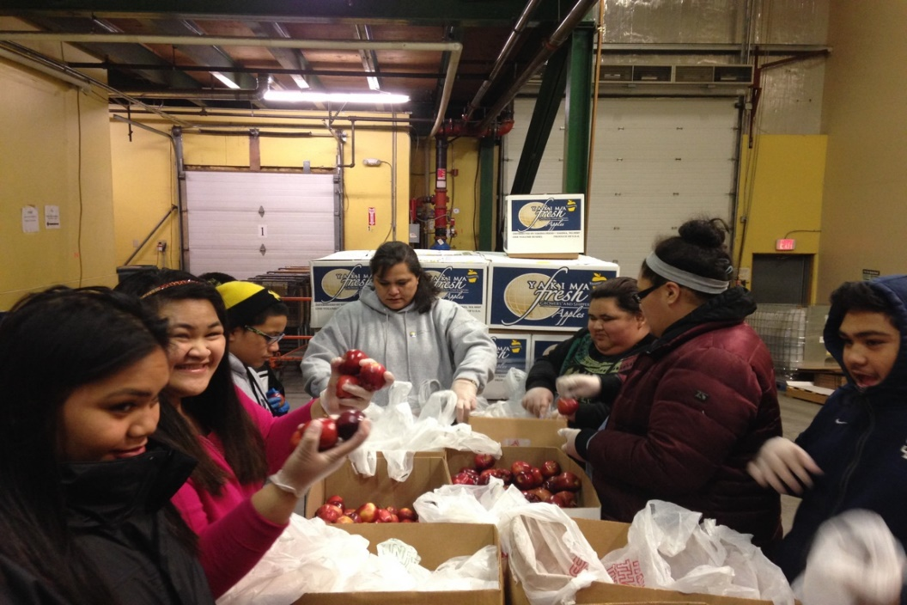
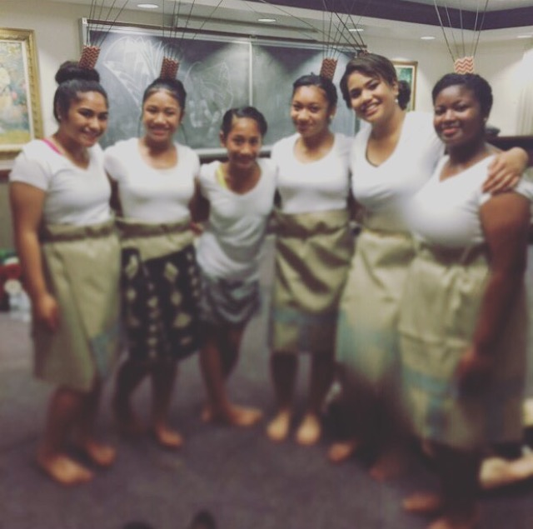

Slide 22
A Samoan Proverb
“Ua o gatasi le futia ma le umele”
Translation: We must be of one mind in the undertaking
While the fisherman swings the rod, the others must assist him by paddling hard

